Slide 1
HTML

Slide 2

Structured documents
HTML – “Hypertext Markup Language”
A type of XML
View Source!
Ted Nelson in 1959 “The Back Button”

Slide 3
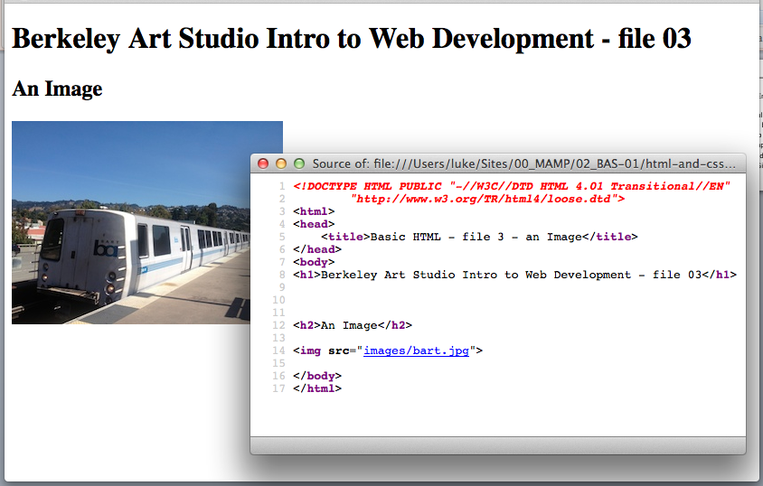
Anatomy of a web page
HTML
CSS
JavaScript
Includes (Images etc)

Slide 4
HTML Example
<html>
<head>
<title>Books</title>
</head>
<body>
<h2>Books</h2>
<hr>
<em>Sense and Sensibility</em>, <b>Jane Austen</b>, 1811<br>
<em>Pride and Prejudice</em>, <b>Jane Austen</b>, 1813<br>
<em>Alice in Wonderland</em>, <b>Lewis Carroll</b>, 1866<br>
<em>Through the Looking Glass<</em>, <b>Lewis Carroll</b>, 1872<br>
</body>
</html>

Slide 5
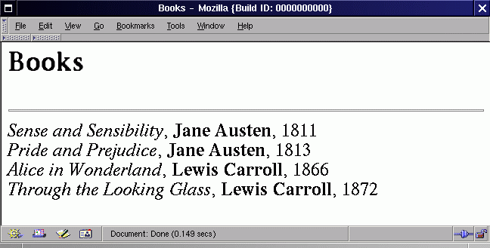
HTML Example - Result

Slide 6
Tags
<tagname>
<tagname>stuff stuff stuff</tagname>
<tagname param=“value” param2=“value”>
<selfclosingtag />

Slide 7
Document Object Model
Might as well get used to the buzzword, it will come in handy later
Tag hiearchy
(Discuss hierarchies)

Slide 8
Overall structure of a document
Doctype
HTML

Slide 9
Structure, expanded one level
Doctype
HTML
Head
Body

Slide 10
Structure, expanded two levels
Doctype
HTML
Head
Title
Metatags
Includes
Body
[Everything you see on a web page]

Slide 11
Typical body
H1
Structure tag
Structure tag
Structure tag
content
Structure tag
content
Structure tag
Structure tag
content
Structure tag
content
Structure tag
Structure tag
content

Slide 12
HTML4 vs HTML5
HTML4
<div>
<span>
HTML 5
<section>
<article>
<aside>
<nav>
<header>
<footer>
https://developer.mozilla.org/en-US/docs/Web/Guide/HTML/Sections_and_Outlines_of_an_HTML5_document

Slide 13
Some HTML tags
Page structure
html
head
body
Info structure
div
span
section
header/footer
Text
h[123456]
p
ul
Links
A
img
link
script
Metadata
comment
title
Formatting
br
em
strong
u
style

Slide 14
Page structure
html – encloses the entire document
head – Needed before anything displays
body – Everything visible

Slide 15
Info structure
div
Contains “blocks” of HTML
span
contains “selections” of HTML
section
Semantic logical divisions
header/footer
Top and bottom of sections

Slide 16
Text
h[123456]
Outline headers. There should only be one “H1” tag per page, but as many of the others as you need.
p
“Paragraph” text, for long text blocks.
ul
“Unordered List” – bulleted list
Contains li (“list item”) tags
ol (“ordered list”) is similar

Slide 17
A (“anchor”) tags
Links pages together – this is what makes the web a web!
Syntax:
<a href=“http://targeturl.com/file”>link text</a>

Slide 18
img (“image”) tags
Inlay images into web pages using HTML
Supplanted largely by CSS
“There’s a funny story...”
Syntax:
<img src=“http://server.com/file.png”>

Slide 19
link
Attach a stylesheet
Syntax:
<link href=“http://url.com/file” rel=“stylesheet” type=“text/css”>

Slide 20
script
Add Javascript
Two forms:
<script> ...javascript code </script>
<script src=“http://url”>

Slide 21
Metadata
comment
<!-- really awkward syntax -->
title
<title>The name of the page</title>

Slide 22
Formatting
br
Line break
em
“Emphasis” – usually rendered as italic
strong
“Strong Emphasis” – usually rendered as bold
u
Underline

Slide 23
style
Include css in-line
<style>
(css code goes here)
</style>
...we’ll have a lot more to say about this!

